Slide 1
Tsunami Protection Program
By: Toby Guenthner, Logan Sheehan, Emilie Baxter, Emmy Nam

Slide 2
Tsunamis
Main causes- Earthquakes and volcanic eruptions
Usually occur in Pacific Ocean in the Ring of Fire
Can travel 16 miles inland
Reaches a height of 1,700 feet

Slide 3
Why are tsunamis dangerous?
Only a minute of warning for people to evacuate
Travels at 500 mph
Contaminates water source
Floods in city for a long period of time

Slide 4
Warning Signals
Earthquake in coastal city
Water recedes abnormally
Roaring noises and sounds

Slide 5
Countries Affected by Tsunamis

Slide 6
Past Tsunamis in Japan
Hoei- 2nd largest tsunami killed 30,000 people (1707)
Mount Unzen- megatsunami and killed 15,000 people (1792)
Meiji-Sanriku- 22,000 people died and 9,000 homes demolished (1896)
Tohoku- 9.0 magnitude caused 5,700 people to die (2011)

Slide 7
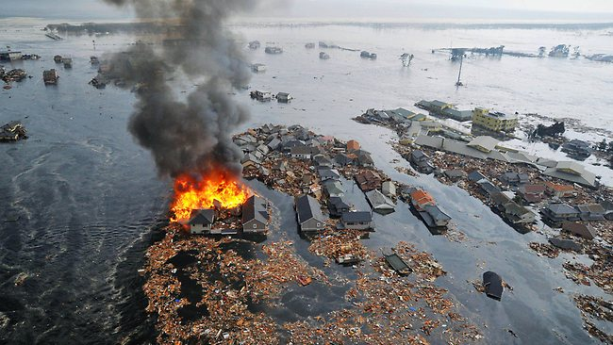
How did the tsunami affect Sendai, Japan?
BEFORE
AFTER
Most recent tsunami in Japan

Slide 8
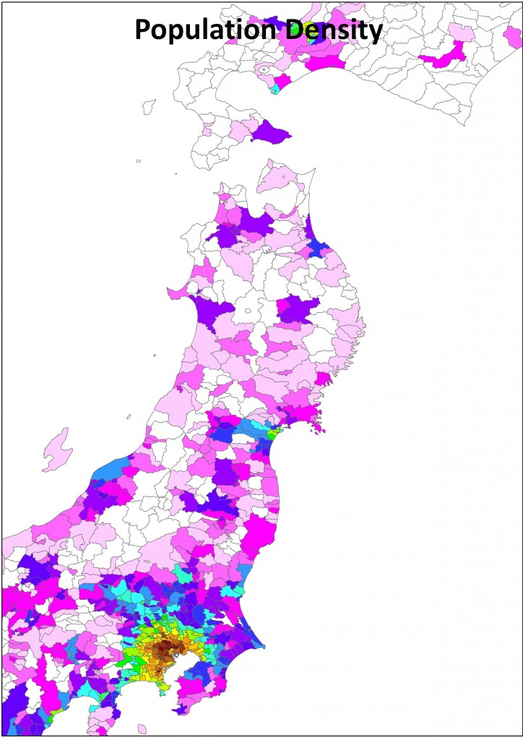

Slide 9
Statistics
Killed 19,000 people
Injured 27,000 people
1,000 children became orphans

Slide 10
Total Deaths

Slide 11
Damage Caused by Tsunami
$574 billion dollars lost in Japan tsunami
Up to 150,000 buildings can be damaged
23 major cities affected

Slide 12
Nuclear Meltdown
The tsunami destroyed a power plant causing a nuclear meltdown
300 tons of radioactive water continues to leak into the Pacific Ocean
Level 7 nuclear meltdown

Slide 13
Cities Affected in Japan

Slide 14
Possible Solutions
Watertight buildings and shelters*
Drainage system for flooding
Giant magical force field
Superglue tectonic plates together
Underwater pressure sensors*
Whale power
Giant vacuum or water bottle
*The ideas we actually used

Slide 15
Underwater Sensors
When water recedes, the sensor broadcasts an alert to weather headquarters to get citizens into shelter or higher ground
The decrease in water pressure causes the sensors to respond

Slide 16
Materials for Watertight Buildings
Tar
Concrete
Steel structure

Slide 17
Dimensions of Watertight Buildings
Two story building that provides space for 80,000 people
Steel wall is 1 foot thick
400 x 200 x 18
80,000 square feet on each story

Slide 18
Cost of Building
Takes 2 years to construct
Approximately 40 million dollars ($30 million for steel)
Other money went to salaries, tar, and concrete

Slide 19
Doors and Windows
The front door slides open and then vacuum seals shut
Door will not release until the water pressure outside the door lessens
No windows to ensure maximum strength
Hatch on roof for emergency escape

Slide 20
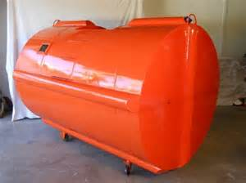
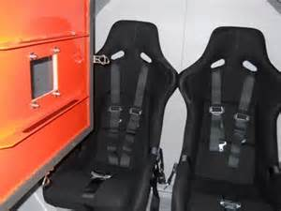
Havana’s Tsunami Survival Pod
We based ideas off steel safety pod
Oxygen provides 3 hours of breathing time
Can withstand 6 tons of debris

Slide 21
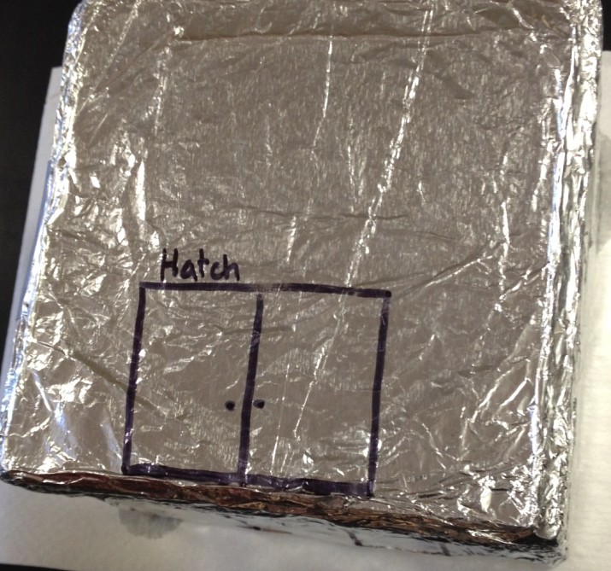
Working Prototype
Built wooden frame
Tinfoil represents steel
Caulk is a substitute for tar

Slide 22
Testing Prototype
Dumped water on prototype to simulate tsunami
Weighed the prototype before and after
Stayed at 560 grams therefore no water entered

Slide 23
Other Benefits
Homeless shelter
Food bank
Community Center
Donation Center (Ex. Blood drive)
Protect power plant

Slide 24
Action Plan
kokusai@jrc.or.jp (Japan Red Cross)
As part of a STEM program in Novato, California, our project was to research and design a solution to a world-wide problem. Natural disasters are a common issue around the globe that can cause mass destruction and many deaths so we are trying to assist people on finding safety. Our plan was to build waterproof buildings to protect important technology, like power plants, and save people’s lives. We based our ideas off boats and survival pods; unfortunately, not everyone can afford these protection pods and we wanted to help the citizens who aren’t as lucky. Even though it may seem expensive at first, this building can benefit Japan in multiple ways, and is inexpensive compared to the money spent to repair Japan’s damage. Thanks for your consideration. - STEM Marin

Slide 25
Thank You For Your Consideration!

