Slide 1
The Hammerhead:
The Hammerhead
A New Innovation of Cars
BY: Scott Fischer, Emmy Nam, Ananya Somasekar, Emilie Baxter
BY: Scott Fischer, Emmy Nam, Ananya Somasekar, Emilie Baxter

Slide 2
A New Innovation of Cars

Slide 3
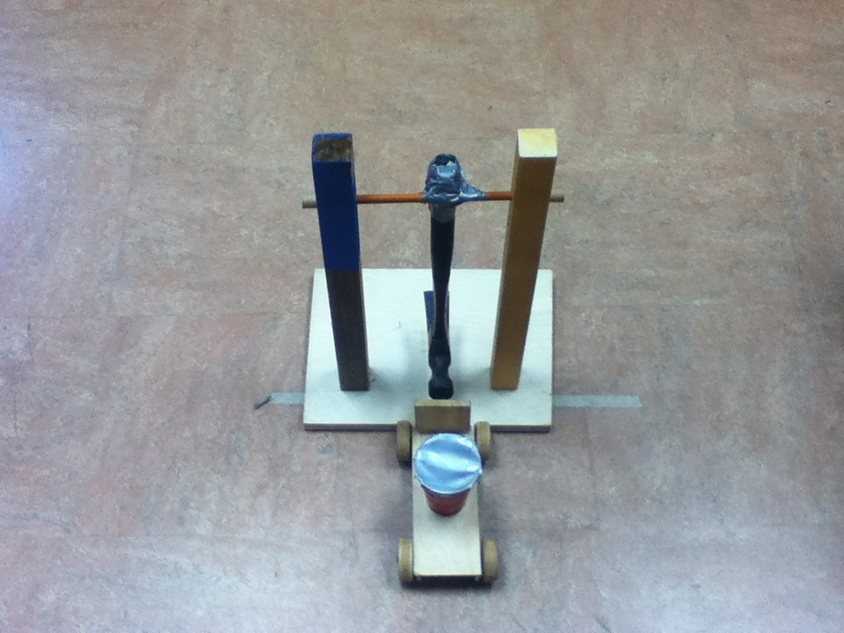
DESIGN:
Our car consists of a wooden body, two wheel and axles, and a hammer pendulum.

Slide 4
Benefits of the Hammerhead Car:
Renewable energy – “Gravity’s got your back”
High rate of acceleration
No hassle of a dead battery
No gasoline
Very sturdy and long lasting
Cost efficient

Slide 5
Average Cost
Materials | Cost (quantity for 1 prototype)
Wood | $7
Hammer | $10
Tinker Toys | $2
Materials | Cost (quantity for 1 car)
Car minus engine | $18,000
Pendulum Engine | $2,000
Total Cost | $20,000
On average, gas would cost you $9,000 a year!
Gas for The Hammerhead costs $0!

Slide 7
Gravitational Potential Energy: energy an object processes due to gravity
Energy stored to convert into kinetic energy or motion
Prototype: PE = 4.34 J
Car: PE = 6,273.27 J (mass of car contributes to hammer’s force - larger potential energy)

Slide 8
A lot of energy is converted into thermal energy which is cause by friction.

Slide 9
The Hammerhead: In Action

